Slide 1

Domain: MATLAB
Technology:Communications
Covert Wireless Communication in IoT Network: From AWGN Channel to THz Band
<Name of the Students>

Slide 2
Index
Abstract
Introduction
Literature review
Existing Method
Disadvantages
Proposed method
Advantages
Applications
Hardware and Software Requirements
Results
Conclusion
Future Scope
References

Slide 3
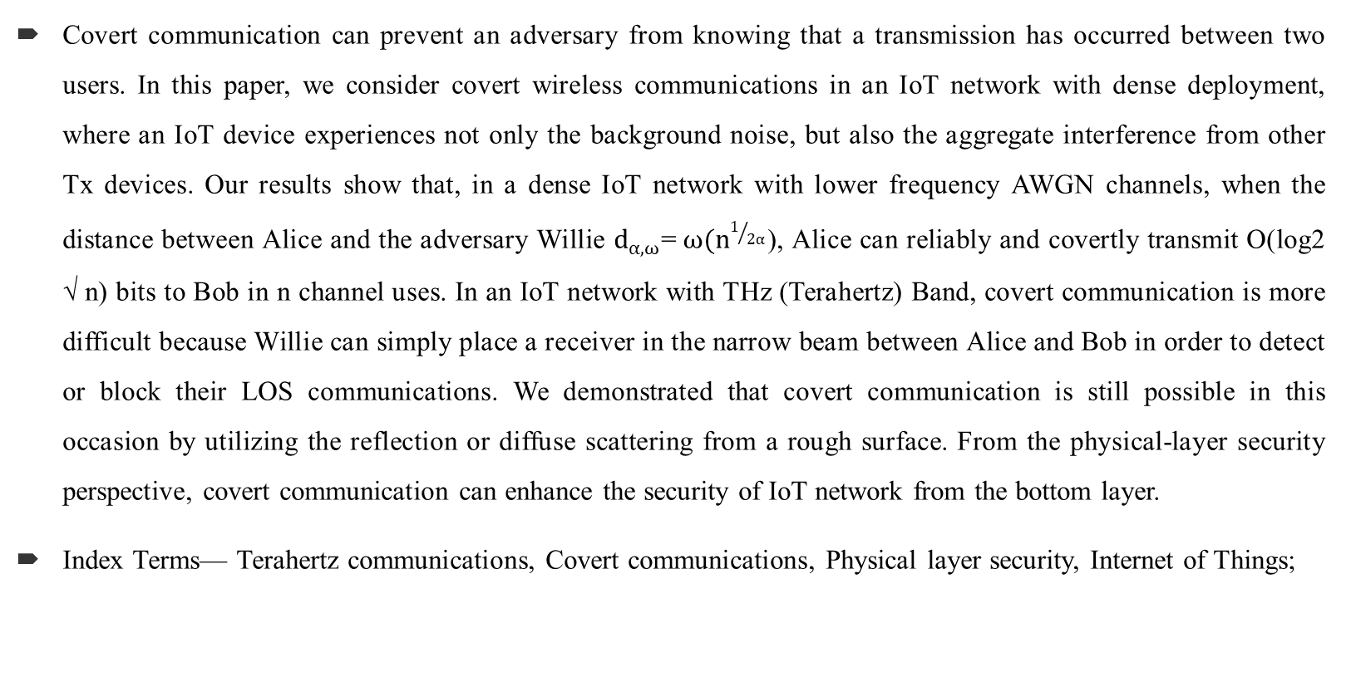
Abstract:
Covert communication can prevent an adversary from knowing that a transmission has occurred between two users. In this paper, we consider covert wireless communications in an IoT network with dense deployment, where an IoT device experiences not only the background noise, but also the aggregate interference from other Tx devices. Our results show that, in a dense IoT network with lower frequency AWGN channels, when the distance between Alice and the adversary Willie $d_{α,ω}$=$ω(n^{1/{2α}}$), Alice can reliably and covertly transmit O(log2 √ n) bits to Bob in n channel uses. In an IoT network with THz (Terahertz) Band, covert communication is more difficult because Willie can simply place a receiver in the narrow beam between Alice and Bob in order to detect or block their LOS communications. We demonstrated that covert communication is still possible in this occasion by utilizing the reflection or diffuse scattering from a rough surface. From the physical-layer security perspective, covert communication can enhance the security of IoT network from the bottom layer.
Index Terms— Terahertz communications, Covert communications, Physical layer security, Internet of Things;

Slide 4
Introduction:
The Internet of Things (IoT) is dramatically changing our daily lives. Meanwhile, security issue is becoming one of the primary tasks of IoT in the coming years. Traditional cryptography methods for network security cannot solve all security problems. If a user wishes to communicate covertly (without being detected by other detectors), encryption to preventing eavesdropping is not enough . Even if a message is encrypted, the metadata, such as network traffic pattern, can reveal some sensitive information . In a battlefield, soldiers hope to hide their tracks so they need to communicate stealthy. Furthermore, if an adversary cannot detect the transmissions, he has no chance to launch the “eavesdropping and decoding” attack even if he has boundless computing and storage capabilities.
Covert communication means exchanging information using a covert (or hidden) channel.Covert channels are used for the secret transfer of information. Encryption only protects communication from being decoded by unauthorised parties, whereas covert channels aim to hide the very existence of the communication
Covert communication at physical-layer has a long history. It is always related with “wireless steganography”, i.e., hidden information is embedded into a cover signal to construct a covert channel, such as encoding information on top of the training sequences of WiFi, the cyclic prefix of WiFi OFDM symbols , or a dirty WiFi QPSK constellation. In this paper, we consider physical-layer covert communication.

Slide 5
Literature Review:
S. No | Journal Type with year | Authors | Title | Outcomes
1 | IEEE Internet of Things Journal, vol. 4, no. 5, pp. 1125–1142, October 2017. | J. Lin, W. Yu, N. Zhang, X. Yang, H. Zhang, and W. Zhao: | A survey on internet of things: Architecture, enabling technologies, security and privacy, and applications, | The detected lines in synthetic aperature radar (SAR) scenes
2 | IEEE Internet of Things Journal, vol. 5, no. 4, pp. 2483–2495, August 2018. | M. Frustaci, P. Pace, G. Aloi, and G. Fortino | Evaluating critical security issues of the iot world: Present and future challenges, | Structure detected and statistical adaptive filtering in SAR images
3 | IEEE Internet of Things Journal, vol. 6, no. 2, pp. 2103–2115, April 2019 | Y. Lu and L. D. Xu | Internet of things (iot) cybersecurity research: A review of current research topics | Initializing, back propagation and generalizing of feed forward classifier
4 | IEEE Internet of Things Journal, vol. 6, no. 4, pp. 7201–7212, Aug 2019. | Y. Miao, X. Liu, K. R. Choo, R. H. Deng, H. Wu, and H. Li | Fair and dynamic data sharing framework in cloud-assisted internet of everything, | Detecting the objects and boundaries in real world images

Slide 6
Proposed Method:
Bash, Goeckel, and Towsley’s work [10] is the first work that puts information theoretic bound on covert wireless communication. A square root law is found over noisy AWGN channels and quantum channels [13]. In a different model, if Alice transmits only once in a long sequence of possible transmission slots and Willie does not know the time of transmission attempts, Alice can reliably transmit O(min{ √ n log(T(n)), n}) bits to Bob with a slotted AWGN channel [14]. To improve the performance of covert communication, Lee et al. [15] found that, Willie has measurement uncertainty about its noise level due to the existence of SNR wall, then they obtained an asymptotic privacy rate which approaches a non-zero constant. Following Lee’s work, He et al. [16] defined new metrics to gauge covertness of communication, and Liu et al. [17] took the interference measurement uncertainty into considerations. In general, the covertness is due to the existence of noise, and Willie cannot accurately distinguish it from user’s signals. Cooperative jamming is regarded as a prevalent physical-layer security approach [18][19] which can increase the measurement uncertainty of the adversary. Sobers et al. utilized cooperative jamming to carry out covert communications. To achieve the transmission of O(n) bits covertly to Bob over n uses of channel, they added a “jammer” to the environment to help Alice for security objectives. Soltani et al. [21] considered a network scenario where multiple “friendly” nodes generate artificial noise to hide the transmission from multiple adversaries. He et al. studied covert communication in wireless networks in which Bob and Willie are subject to uncertain shot noise from interferers.

Slide 7
Disadvantages in Existing Method:
1.Low Security
2.Low frequency bands are used.

Slide 8
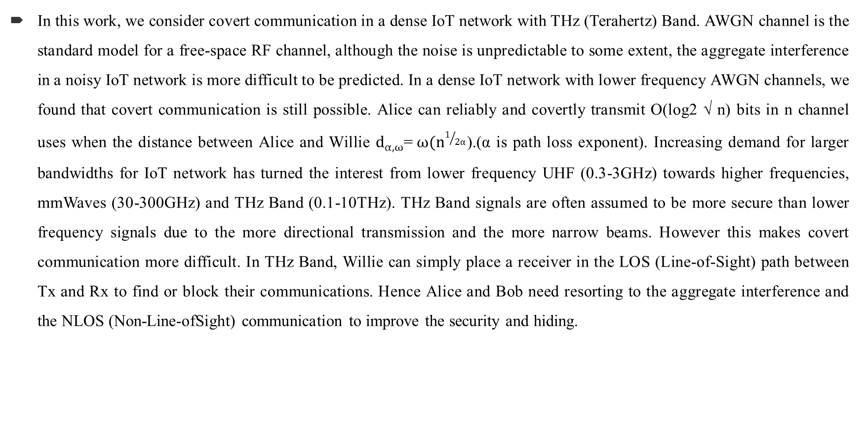
Proposed Method:
In this work, we consider covert communication in a dense IoT network with THz (Terahertz) Band. AWGN channel is the standard model for a free-space RF channel, although the noise is unpredictable to some extent, the aggregate interference in a noisy IoT network is more difficult to be predicted. In a dense IoT network with lower frequency AWGN channels, we found that covert communication is still possible. Alice can reliably and covertly transmit O(log2 √ n) bits in n channel uses when the distance between Alice and Willie $d_{α,ω}$=$ω(n^{1/{2α}}$).(α is path loss exponent). Increasing demand for larger bandwidths for IoT network has turned the interest from lower frequency UHF (0.3-3GHz) towards higher frequencies, mmWaves (30-300GHz) and THz Band (0.1-10THz). THz Band signals are often assumed to be more secure than lower frequency signals due to the more directional transmission and the more narrow beams. However this makes covert communication more difficult. In THz Band, Willie can simply place a receiver in the LOS (Line-of-Sight) path between Tx and Rx to find or block their communications. Hence Alice and Bob need resorting to the aggregate interference and the NLOS (Non-Line-ofSight) communication to improve the security and hiding.

Slide 9
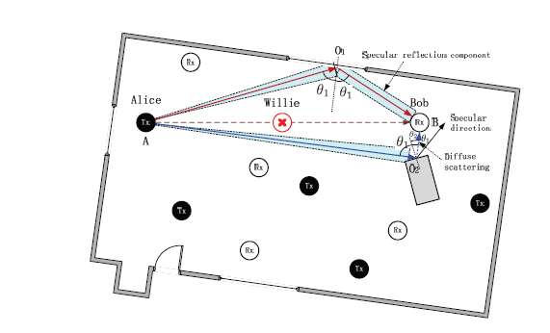
Proposed Method:
In a THz Band IoT network, although the LOS communications can be detected easily by Willie, we found that the communication based on reflection or diffuse scattering is a feasible information hiding method. As depicted in Fig., the communication via specular reflection A-O1-B or diffuse scattering A-O2-B can evade the detection. The scattering signals Willie eavesdropping are masked by the background noise and the aggregate interference in a dense IoT network.
To bypass the detection of Willie, Alice and Bob should resort to the reflection or diffuse scattering NLOS transmission link, • Specular Reflection: At first, Alice and Bob try to find a surface in the surroundings that the THz beam from Alice can be specularly reflected to the antenna of Bob, i.e., the specular reflection path AO1 and O1B in Fig., and SINR at Bob is above a predefined threshold. Diffuse Scattering: If a specular reflection path does not exist, Alice and Bob find a diffuse scattering path so that Bob’s received signal strength is above a threshold, such as the scattering path AO2 and O2B in Fig.
Fig. Covert communication in a THz Band IoT network.

Slide 10
Advantages of Proposed Method:
Increase signal covertness.
High frequency bands are used.

Slide 11
Applications of Proposed Method:
Military Applications
E-mail,
Virtual private networks (VPNs),
Internet browsers (Secure Sockets Layer and Transport Layer Security Protocols)

Slide 12
Hardware & Software Requirements:
Software: Matlab 2018a or above
Hardware:
Operating Systems:
• Windows 10
• Windows 7 Service Pack 1
• Windows Server 2019
• Windows Server 2016
Processors:
Minimum: Any Intel or AMD x86-64 processor
Recommended: Any Intel or AMD x86-64 processor with four logical cores and AVX2 instruction set support
Disk:
Minimum: 2.9 GB of HDD space for MATLAB only, 5-8 GB for a typical installation
Recommended: An SSD is recommended A full installation of all MathWorks products may take up to 29 GB of disk space
RAM:
Minimum: 4 GB
Recommended: 8 GB

Slide 13
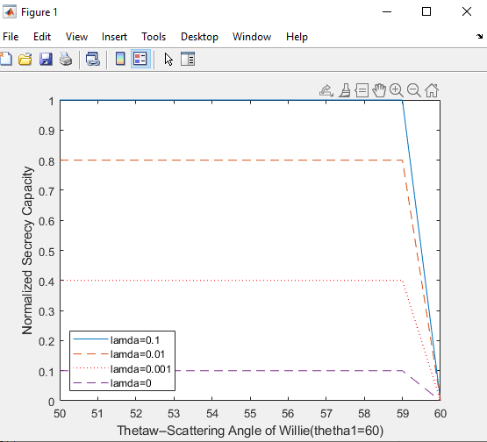
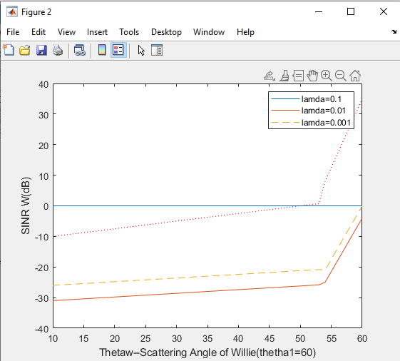
Results and Discussions:
Fig: Normalized secrecy capacity c¯s
Fig:SINRW (dB)

Slide 14
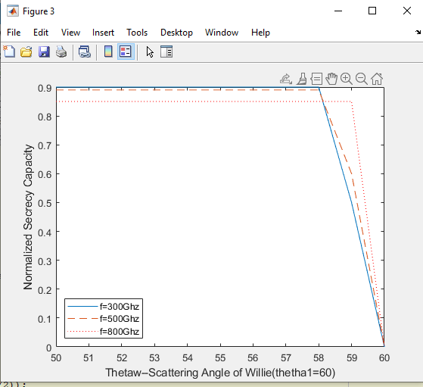
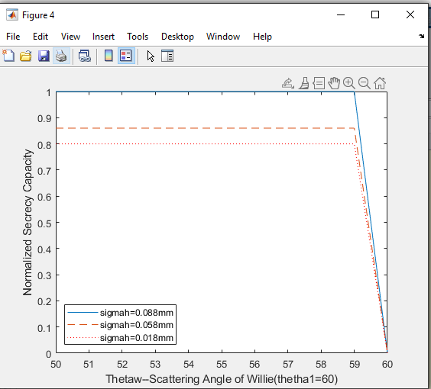
Results and Discussions:
Fig. The normalized secrecy capacity c¯s versus the scattering angle of Willie θW for different operating frequencies
Fig. The normalized secrecy capacity c¯s versus the scattering angle of Willie θW for different surface roughnesses σh.

Slide 15
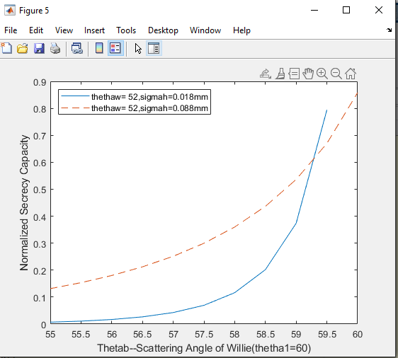
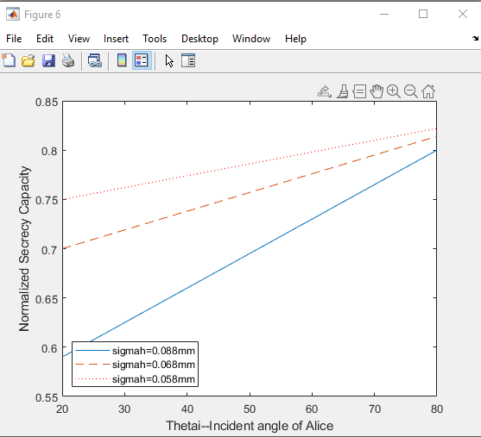
Cont..
Fig. The normalized secrecy capacity c¯s versus the scattering angle of Bob θB for different surface roughness σh
Fig. The normalized secrecy capacity c¯s versus the incident angle of signal θ1 for different surface roughnesses σh

Slide 16
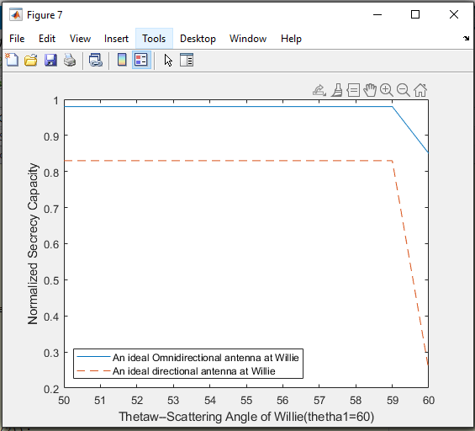
Fig. The normalized secrecy capacity c¯s versus the scattering angle of Willie θW for different antennas of Willie

Slide 17
Conclusion:
Security is the foundation for the development of IoT network. However, how to protect IoT is a challenging task and many related issues need to be solved. From the physical layer security perspective, this paper introduces covert communication into IoT network to enhance the security from the bottom layer. If the adversary cannot detect user’s transmission behavior, he has no chance to launch other attacks. What he sees is merely a shadow noisy wireless network

Slide 18
Future Scope
Willie is faced with a dilemma of how to determine the type of antenna.so ,the The future scope is that which type of antenna is used or what particular antenna should be used ,and further different modulations can be used

Slide 19
References:
[1] J. Lin, W. Yu, N. Zhang, X. Yang, H. Zhang, and W. Zhao, “A survey on internet of things: Architecture, enabling technologies, security and privacy, and applications,” IEEE Internet of Things Journal, vol. 4, no. 5, pp. 1125–1142, October 2017.
[2] M. Frustaci, P. Pace, G. Aloi, and G. Fortino, “Evaluating critical security issues of the iot world: Present and future challenges,” IEEE Internet of Things Journal, vol. 5, no. 4, pp. 2483–2495, August 2018.
[3] Y. Lu and L. D. Xu, “Internet of things (iot) cybersecurity research: A review of current research topics,” IEEE Internet of Things Journal, vol. 6, no. 2, pp. 2103–2115, April 2019.
[4] Y. Miao, X. Liu, K. R. Choo, R. H. Deng, H. Wu, and H. Li, “Fair and dynamic data sharing framework in cloud-assisted internet of everything,” IEEE Internet of Things Journal, vol. 6, no. 4, pp. 7201–7212, Aug 2019.
[5] B. A. Bash, D. Goeckel, D. Towsley, and S. Guha, “Hiding information in noise: Fundamental limits of covert wireless communication,” IEEE Communications Magazine, vol. 52, no. 12, pp. 26–31, December 2015

